Slide 1

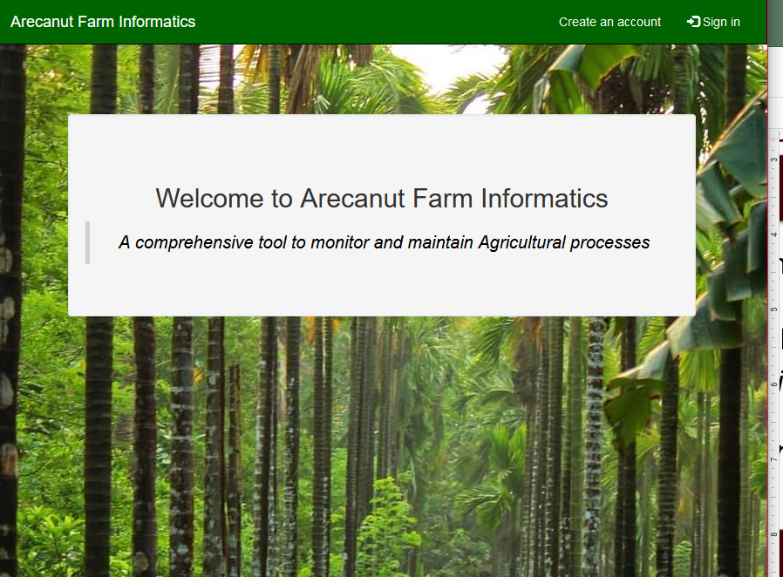
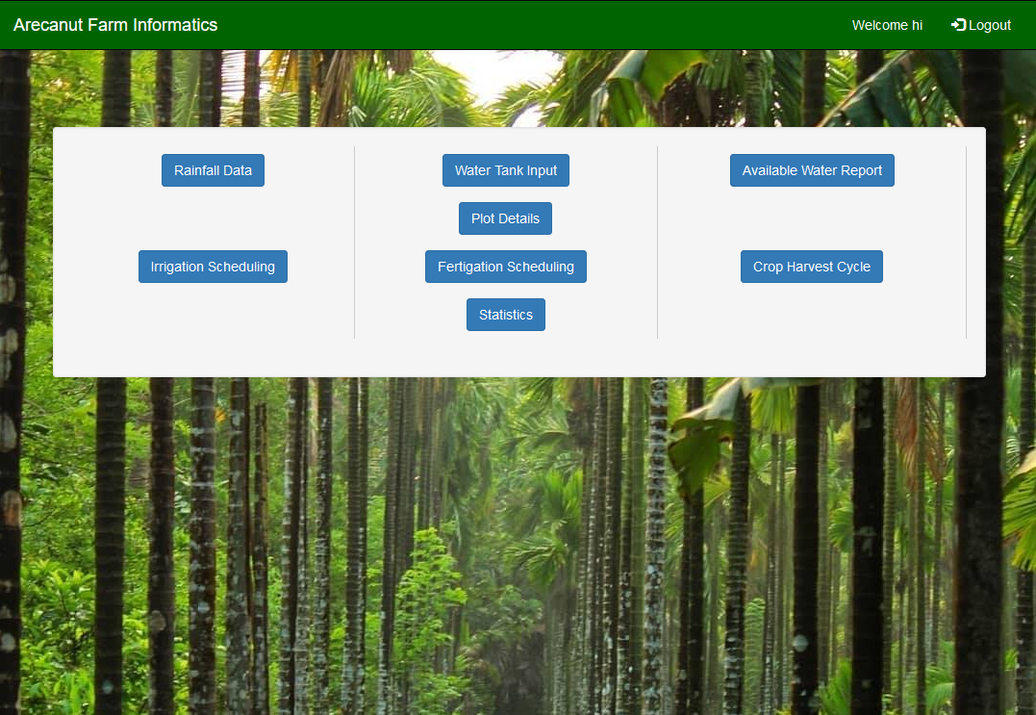
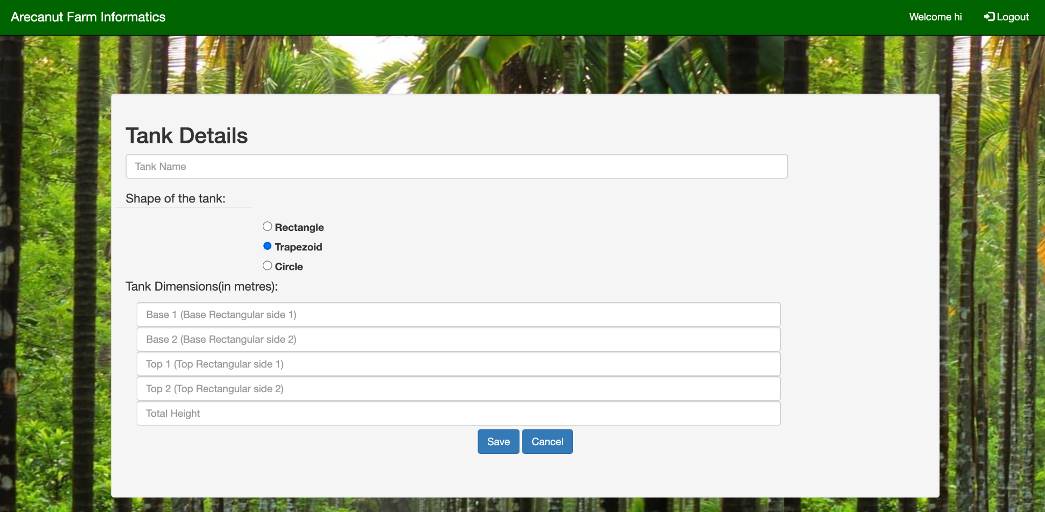
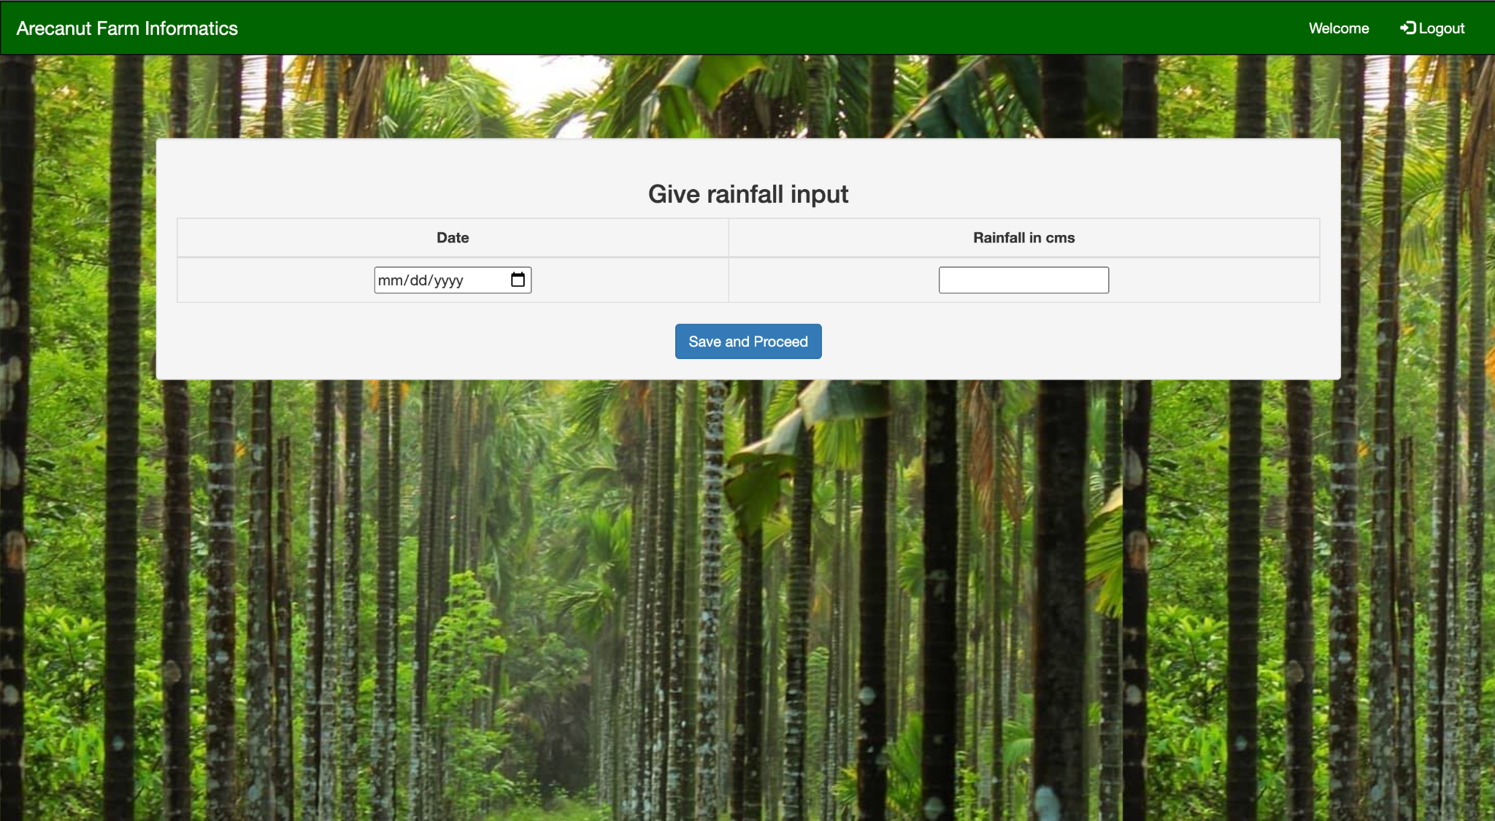
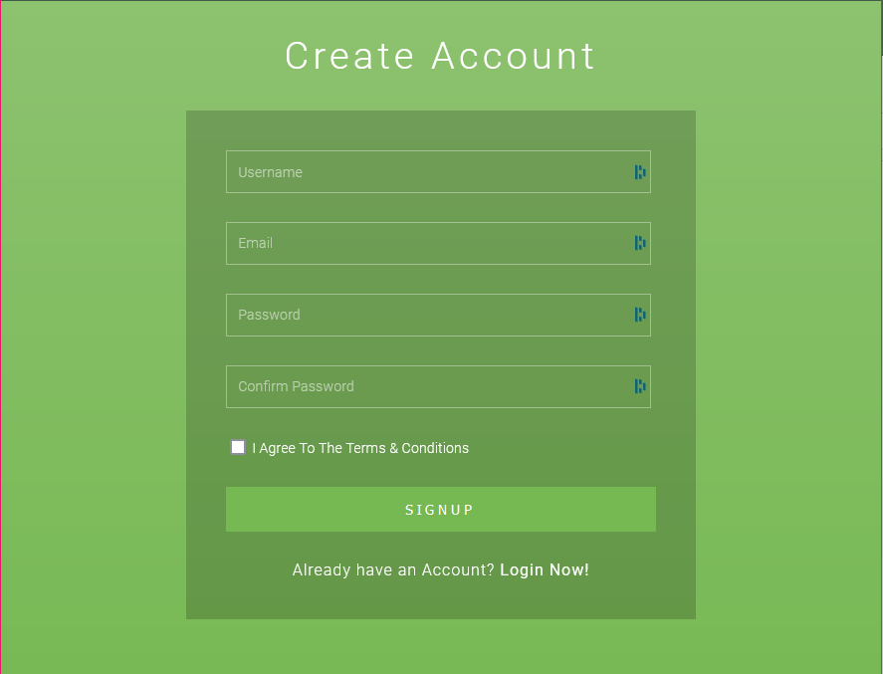
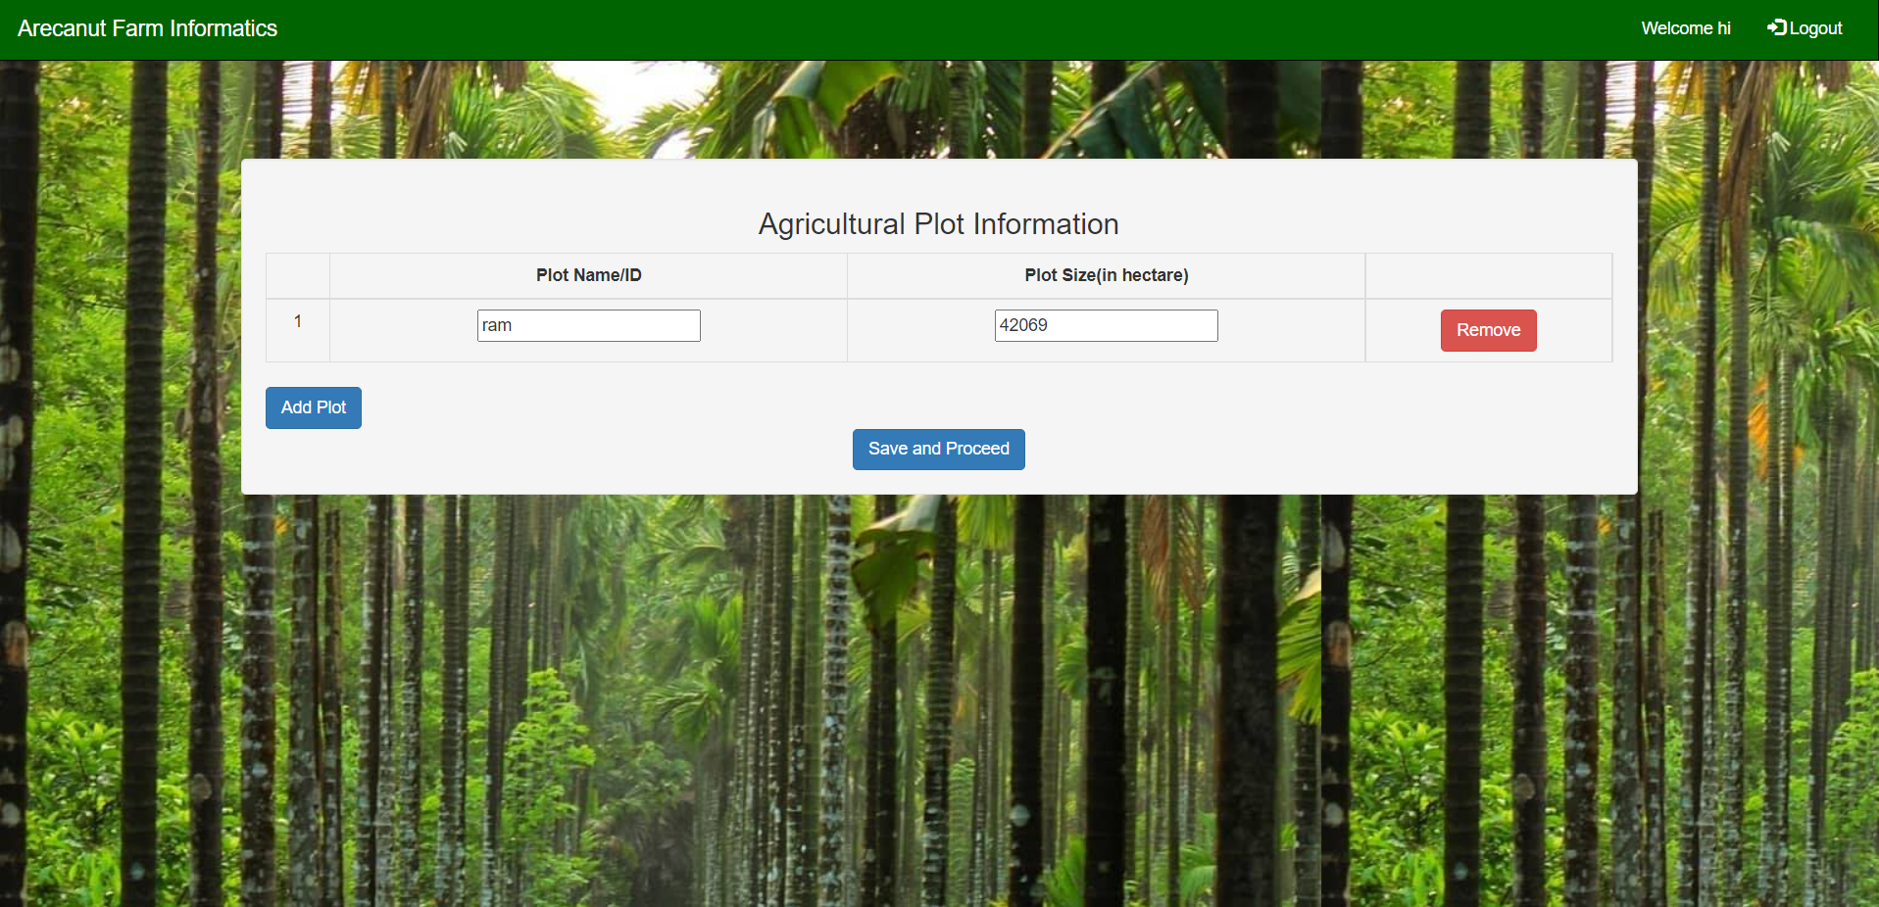
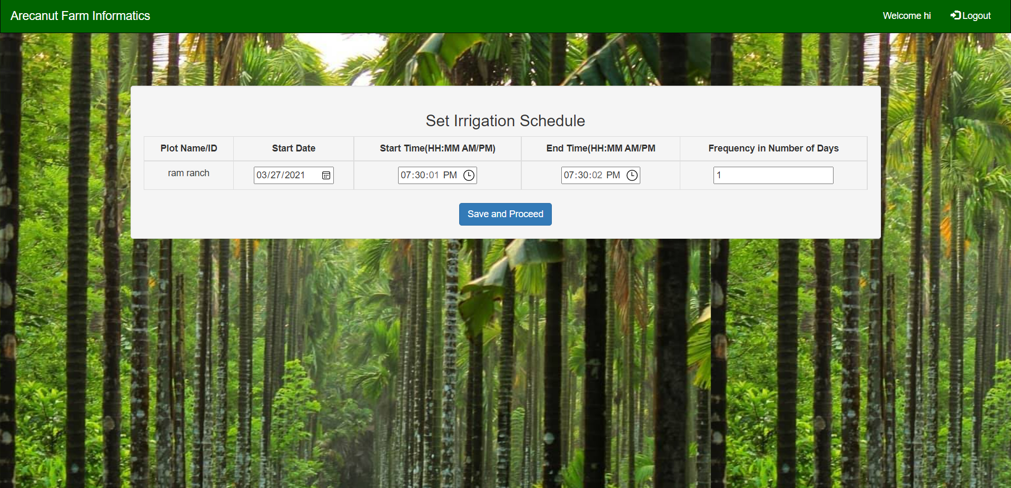
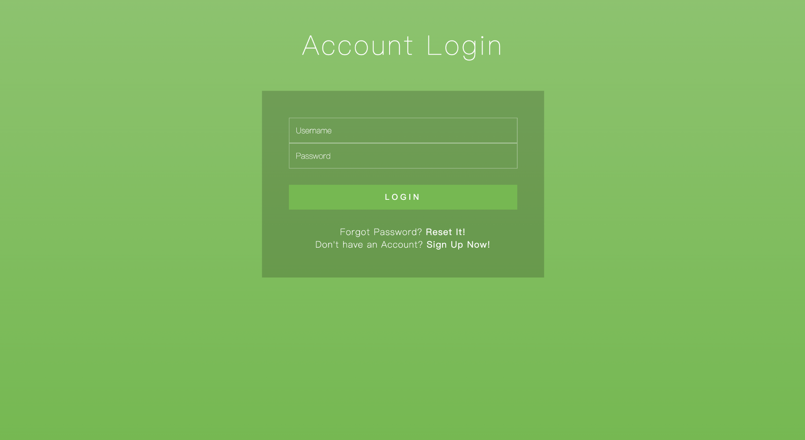
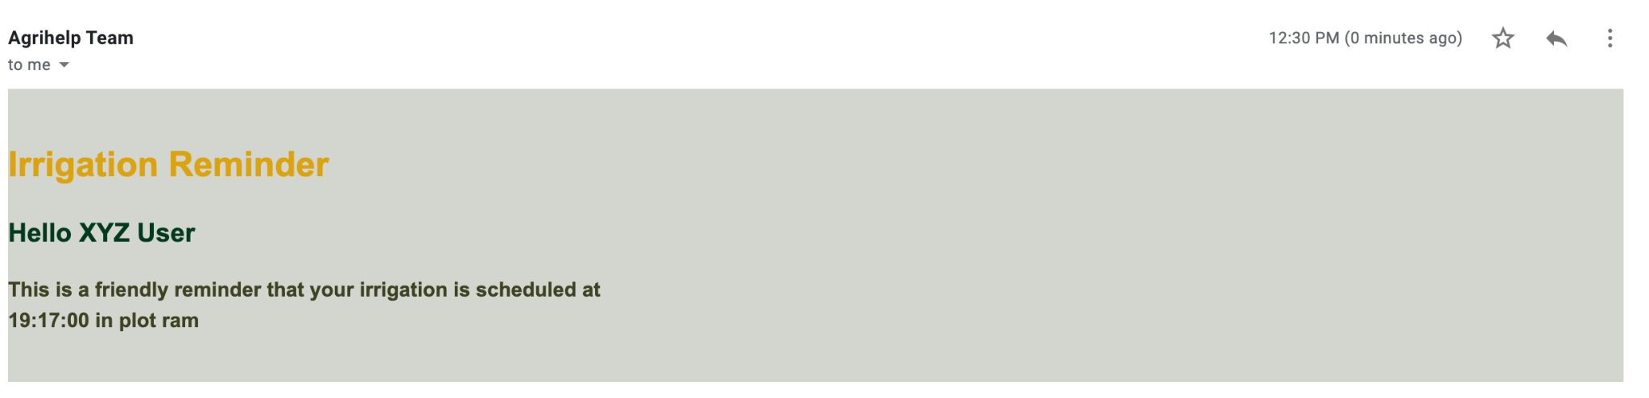
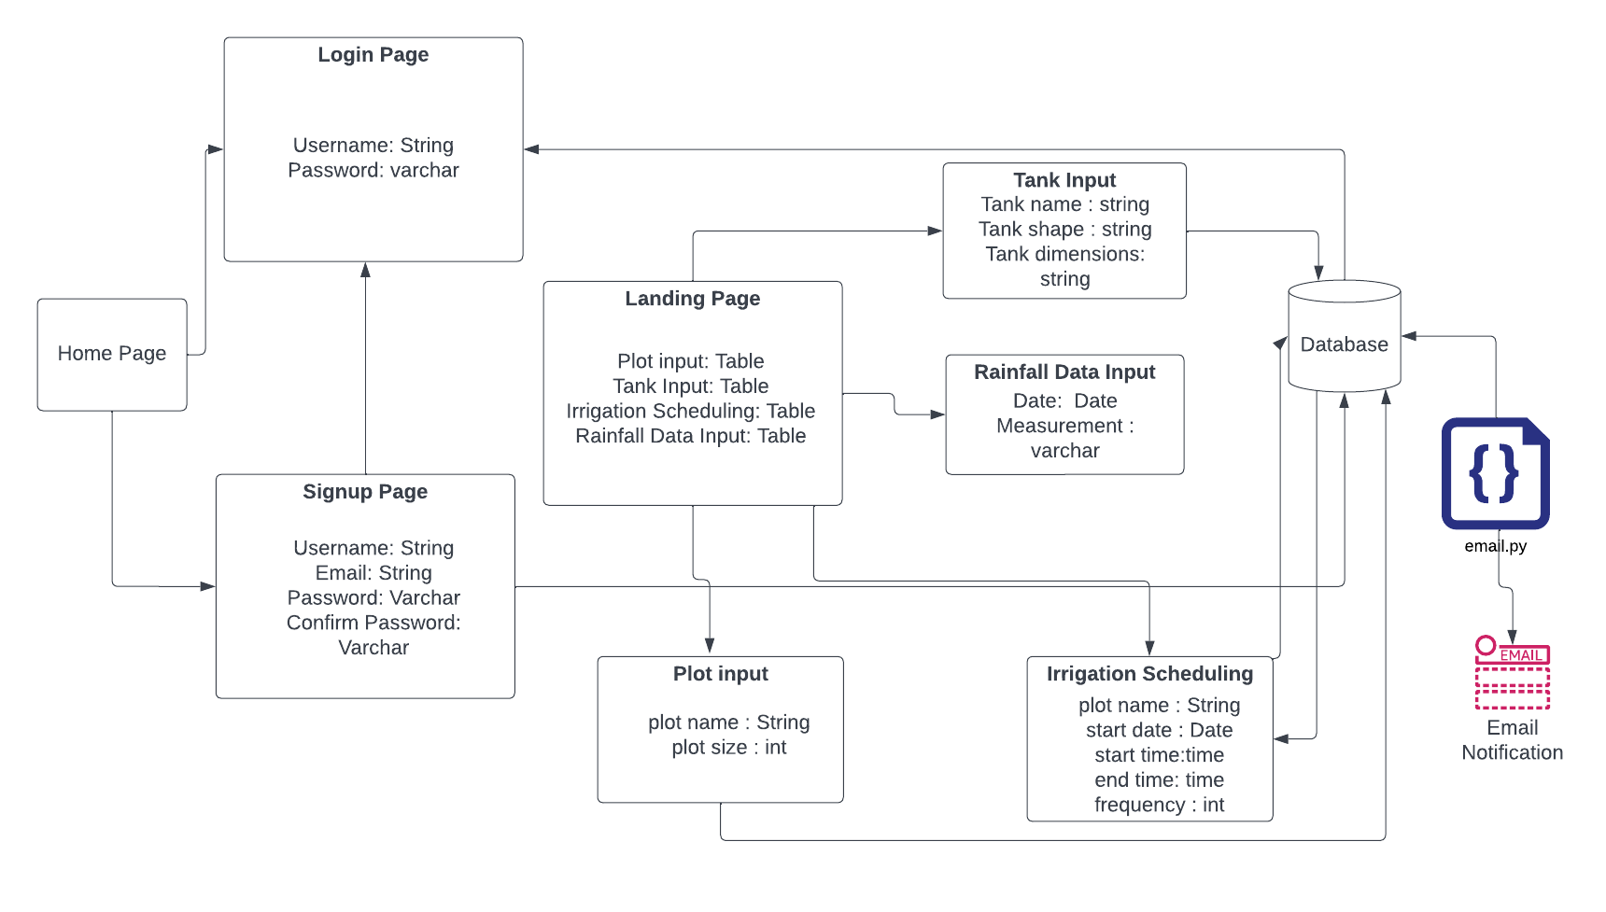
Arecanut Farm Informatics
Sindura Saraswathi, Rimsha Maredia, Sai Shreyashi Penugonda, Feras Khemakhem, Siri Namburi
Department of Computer Science and Engineering, Texas A&M University
Introduction
Home Pages
Target customer: Mahesh Prasanna
Goal: An application that tracks users’ farm data to help them maintain and monitor their assets
Product: A web application that monitors Arecanut farm management through features like plot information, rainfall data, water tank reservoirs data, irrigation schedule, and other agricultural aspects
Software Stack:
Front-End: HTML/CSS
Database: MySQL
Back-End: Flask with Python
Deployment: Heroku
Motivation
Home page of the application with Login and Sign-Up options as well as some basic info about the application.
Landing page post login showing current functionalities and some placeholder functionalities for future work.
In India, Arecanut is cultivated in 400,000 hectares of land with a production of nearly 5 Lakh Tonnes. It has commercial and economical importance not only in India but also in China and Southeast Asia. Arecanut farms are generally not confined to a small area of land. On the contrary, every farm is spread across a wide area having multiple plots of several acres each. Hence, manually monitoring and maintaining the various agricultural aspects of the farms becomes a huge task for the farmers. In addition to this, during the summer, the majority of the farmers face scarcity of water mainly because of the mismanagement of water resources and it will be difficult to supply the required water to the palms. Hence, water management is very crucial for the farmers so as to use technology to irrigate their farms throughout the summer with the water available.
Farm Data Tracking and Management Pages
User Authentication Pages
This page allows to add water tank input by selecting shape and accordingly add measurements.
This page allows to add past or current day rainfall measurement (in cm) to maintain track of it.
This page is for new users to Sign-Up/ Create their account
This page allows to Add/Delete plot information and then proceed to next page (on right).
This page allows the user to schedule alerts for periodic irrigation of each plot.
This page is for existing users to Login to their account.
Sample email alert for irrigation scheduled by user.
Design Choices and Overall Flow
Challenges and Lessons
BUSINESS: The goal of the application was to aid and help end-user (farmer or manager) to track and manage farm data for which above mentioned functionalities were essential. So the design fulfilled the business use case and caters to end-user.
Having a basic authentication(login and sign-up) helps track the basic user data and respective farm data with ease. The placement of these options in the header helps user focus on the bigger goal to be interacted with the user and later proceed to authentication.
Having a singular landing page with the available functionalities helps user to navigate conveniently using the application interface, easing the overall usage.
UML Diagram of Overall Design
Effective utilization of Agile methodology: Thorough planning anticipated a much more extensive product in the beginning of development, but we failed to foresee the workload and some roadblocks faced. that came with this end goal as a result of miscalibration. We initially planned our entire project out from the beginning and did not fully take advantage of the agile process in that we did not adapt our weekly scrums and also more extensive tracking using pivotal type of tasks could have been used.
Lack of multiple end-user feedback meant the page designs and UI choices were contained within the team and the client . Not accounting for this in our process was a bit of a drawback since varied user inputs were not accessible and on our part as it led to us tunnel visioning our final product.
Keeping descriptive user stories was another challenge that we faced with the software engineering process. User stories were somewhat vague sometimes, leading to confusion on what was to be accomplished specifically within the team.
DESIGN: The subjective design decisions taken were in accordance to existing knowledge of the domain of implementation and customer input. Some such decisions were:
Green based color scheme throughout the application to emphasize the domain of implementation: Farming
The background image in all pages and the well-structure was to aid user to focus on the form to fill to avoid clutter with any background image and avoidance of solid color background to bring more visual focus to the form with the separation from background image as well as maintaining uniformity across.
Upon entering plot details, in order to schedule irrigation the page for the same was a continuing page in order to ensure user enters irrigation scheduling details for each plot, this ensured flow of user actions and information.

